Slide 1
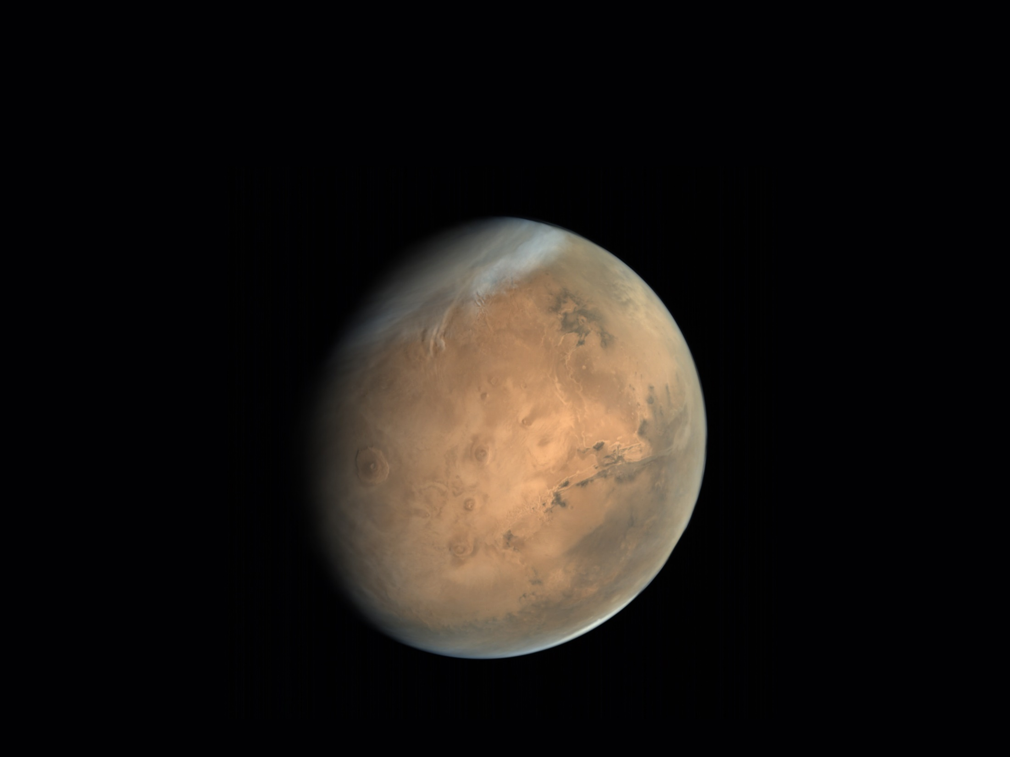
Introduction to Mars
Arizona State University – Walk on Mars
Notes:
This presentation is intended to familiarize students with basic information about Mars prior to participating in the “Walk on Mars” activity.

Slide 2
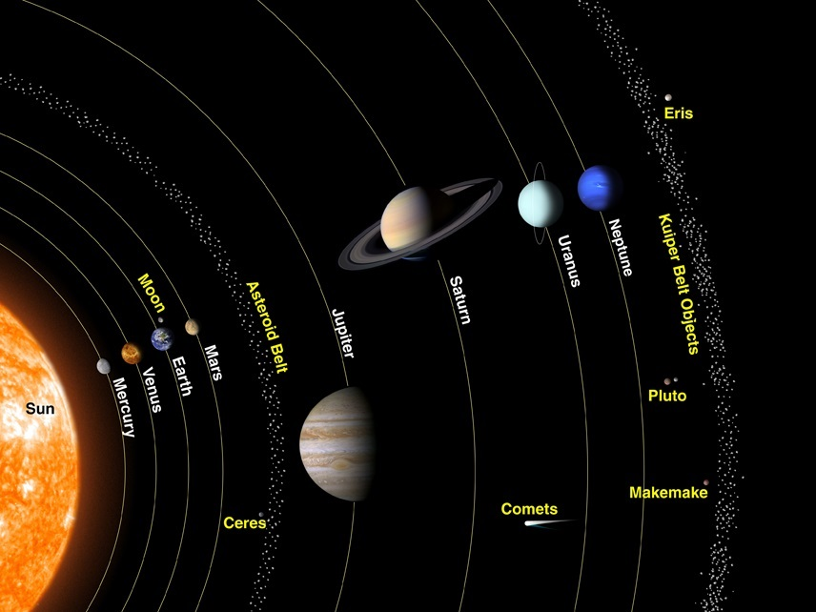
Notes:
Mars is the fourth planet from the Sun, slightly farther out than the Earth, and is one of only five planets that can be seen with the naked eye (Mercury, Venus, Mars, Jupiter and Saturn). Mars often appears in the night sky as a bright red star and with binoculars or a small telescope you can see that Mars is actually a sphere and not a single point of light like a distant star.

Slide 3
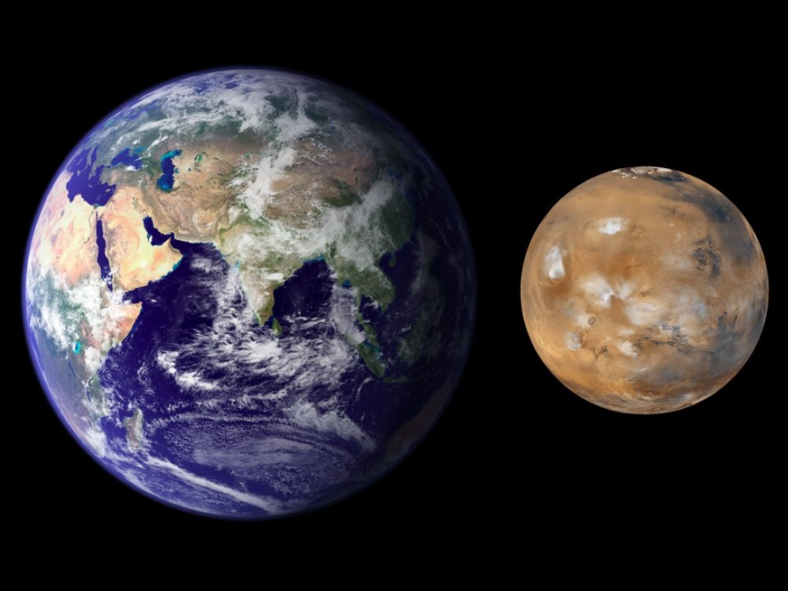
Notes:
The diameter of Mars is approximately half the diameter of the Earth. The mass of Mars is approximately 10% of the mass of the Earth. Because of the lower mass and smaller diameter, a person standing on Mars would weight approximately 1/3 of what they weigh on Earth.

Slide 4
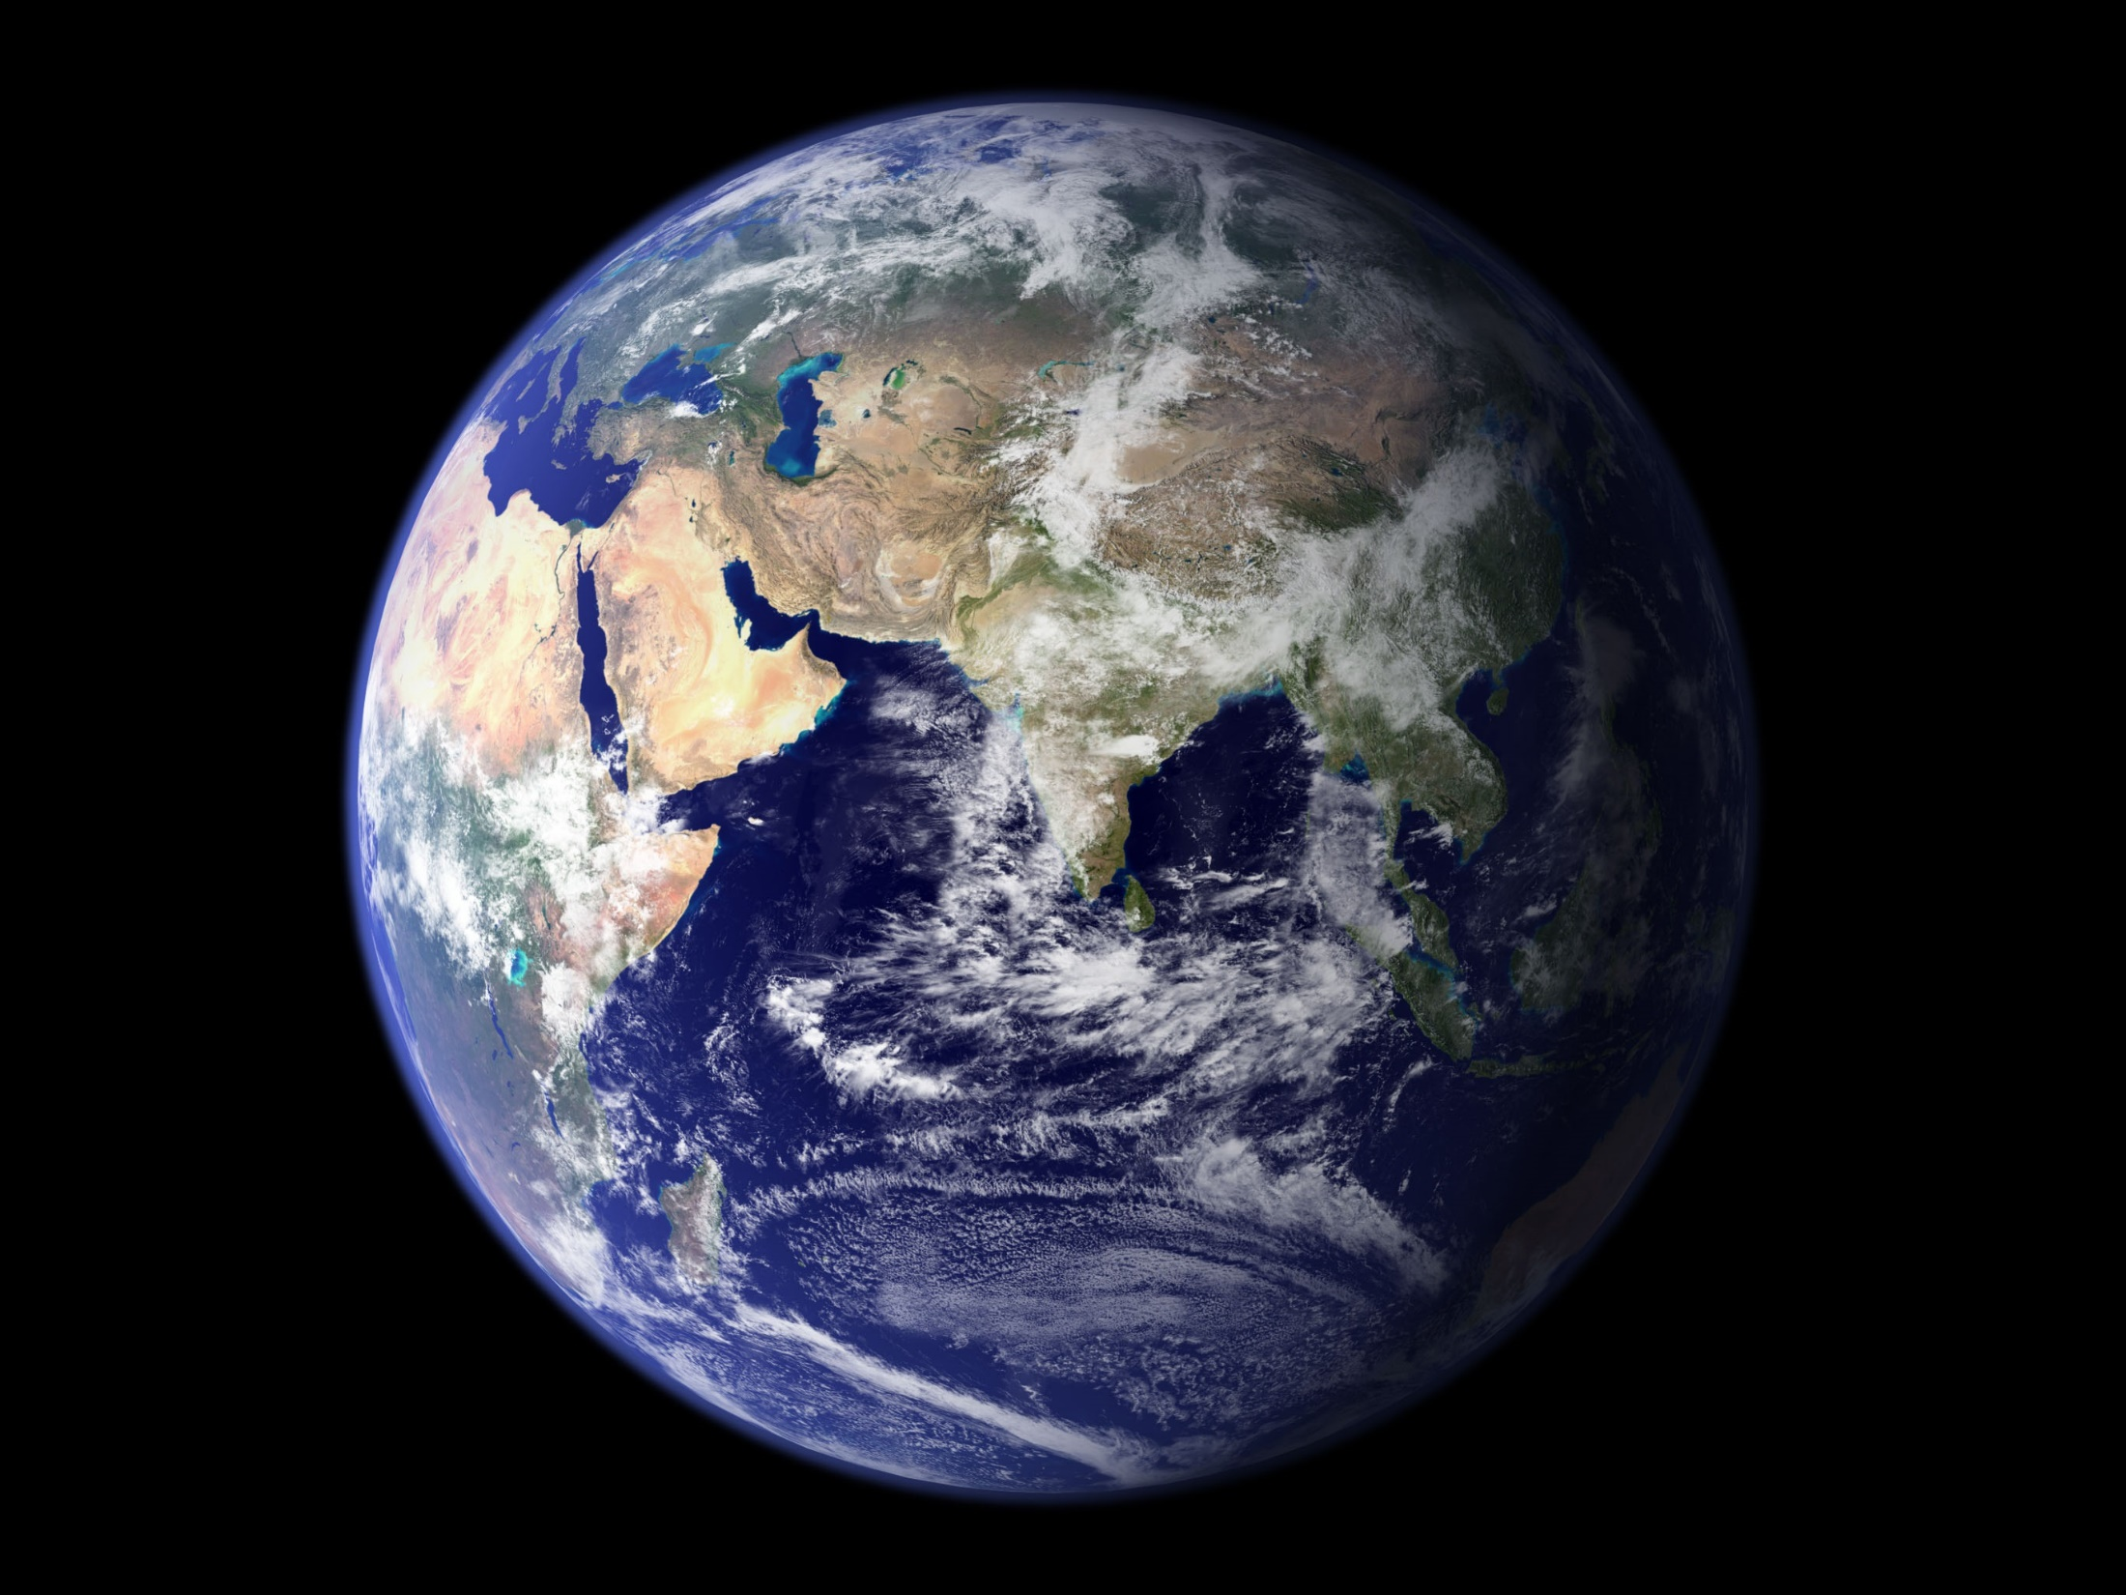
Notes:
All planets, like the Earth, are spheres. However, you can only see one half of a sphere at a time. So if we want to study an entire planet, it is often easier to display it as a rectangular map.

Slide 5
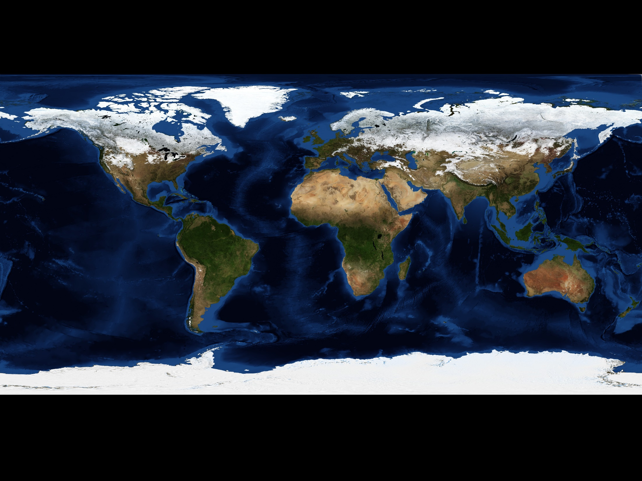
Notes:
When the map of a planet is converted from a sphere to a rectangle, the map becomes distorted near the north and south poles. Features on the map that are close to the poles, like Greenland, get stretched out and appear larger than they actually are. As long as you are aware of this, rectangular maps can be used for scientific analysis.

Slide 6
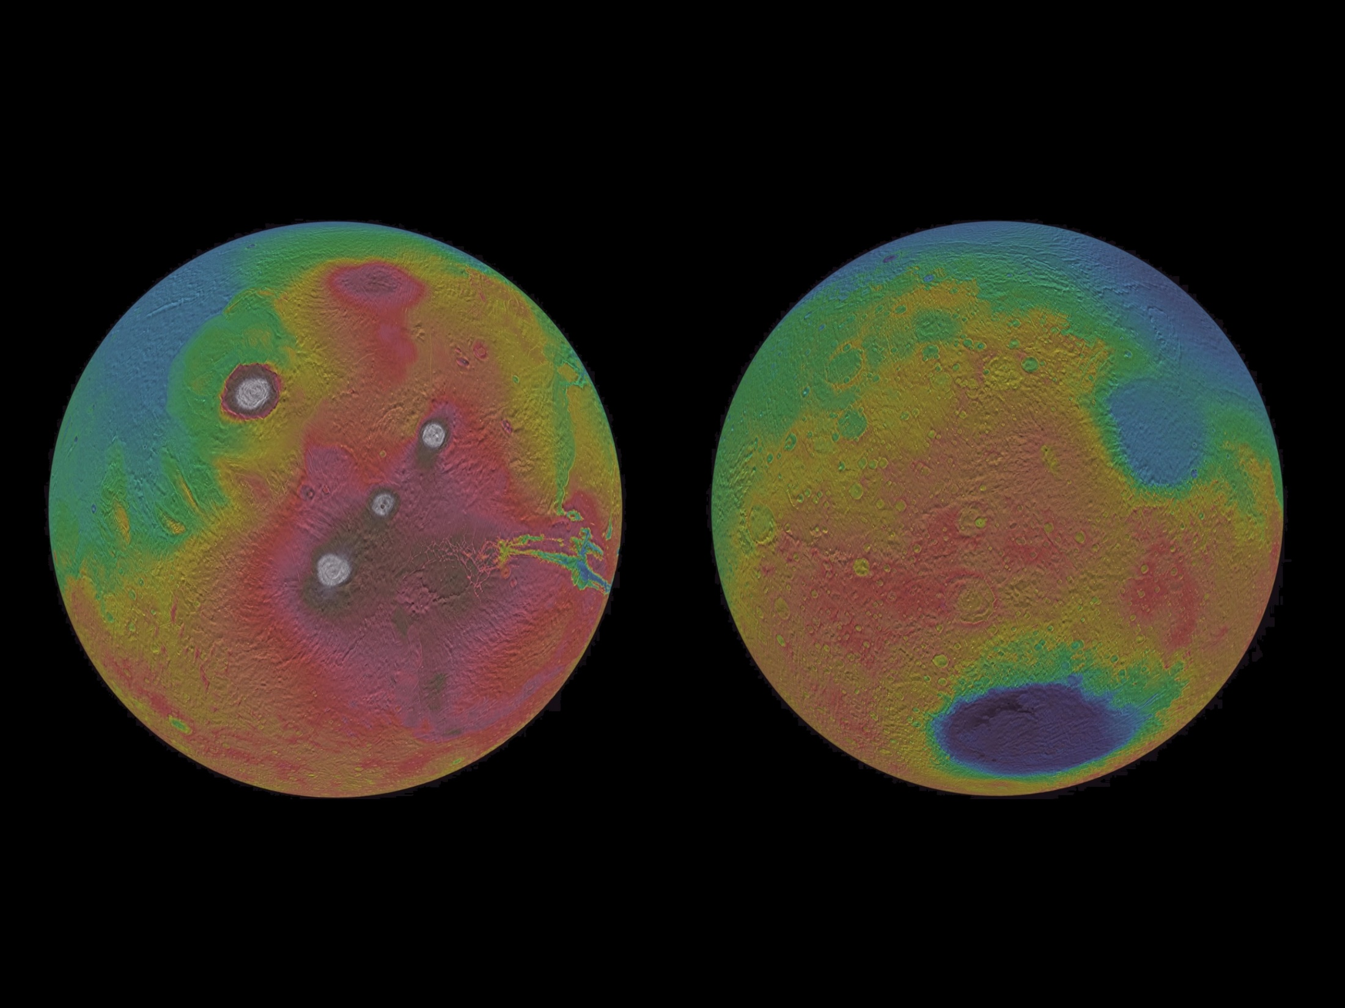
Notes:
Just like the Earth, we have maps of the entire surface of Mars. And just like for maps of the Earth, we can convert the spherical maps into easier-to-view rectangular maps.

Slide 7
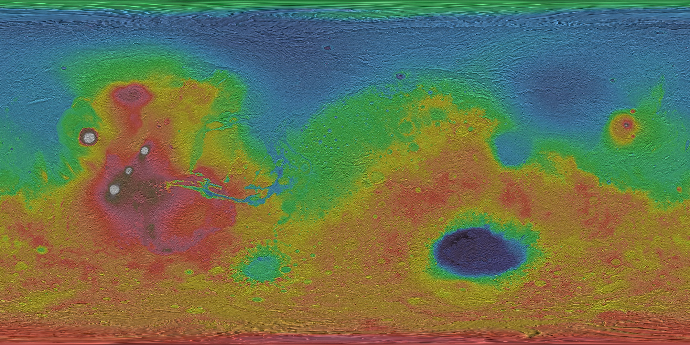
Notes:
This is a topographic map of Mars, which means that it is using colors to show elevations.

Slide 8
Red = High
Notes:
In this particular map, red regions are high.

Slide 9
Blue = Low
Red = High
Notes:
Blue regions are low.

Slide 10
Blue = Low
Green = Average
Red = High
Notes:
Green regions are at the average elevation of the entire planet.

Slide 11
White = Very High
Blue = Low
Green = Average
Red = High
Notes:
Some of the volcanoes on Mars are extremely high, so additional colors (brown and white) have been added at the high end of the scale.

Slide 12
White = Very High
Blue = Low
Green = Average
Purple = Very Low
Red = High
Notes:
And some impact craters are extremely deep, so another color (purple) has been added on the low end of the scale.

Slide 13
Notes:
When viewing the entire map of Mars, there are a couple features that should immediately jump out to you based on their distinctive colors.

Slide 14
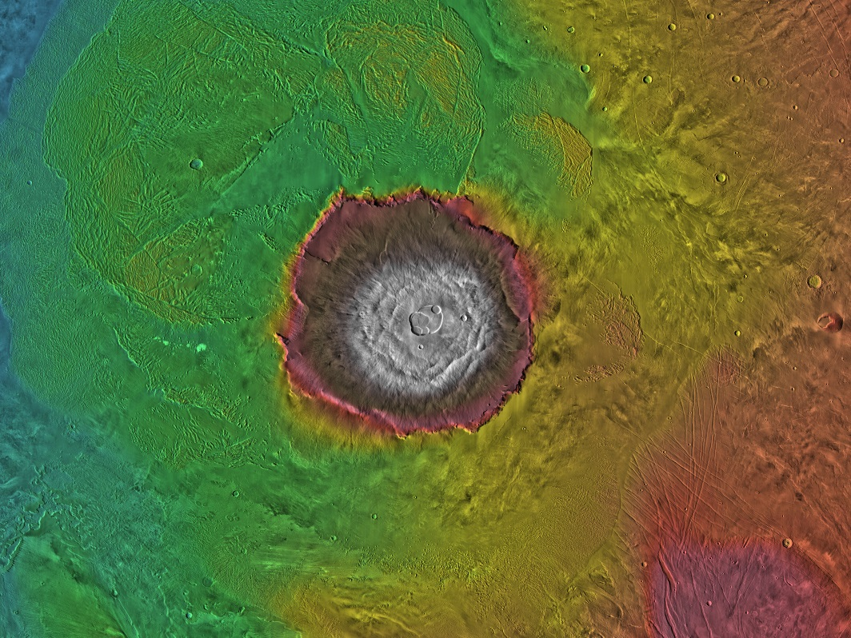
Olympus Mons – Tallest Mountain on Mars
Notes:
Olympus Mons is the tallest mountain on Mars. At almost 74,000 ft tall, it is 2.5 times the height of Mount Everest. Because of this extreme height, the summit shows up as white on this color scale. At it’s base, it is surrounded by steep cliffs that are nearly as high as Mount Everest. It is named after Mount Olympus in Greece, which was the mythological home of the Greek gods.

Slide 15
Olympus Mons – Tallest Mountain on Mars
Notes:
At nearly 350 miles in diameter, Olympus Mons is approximately the same width as Arizona. It is a type of volcano called a shield volcano, much like the volcanoes on the Big Island in Hawai’i. In addition to being very tall, it is also very wide. This makes the slopes on the sides of the volcano very gentle, only a few degrees. If you were standing on the slopes of Olympus Mons, you would probably think you were on flat ground because the slope angle is so small.

Slide 16
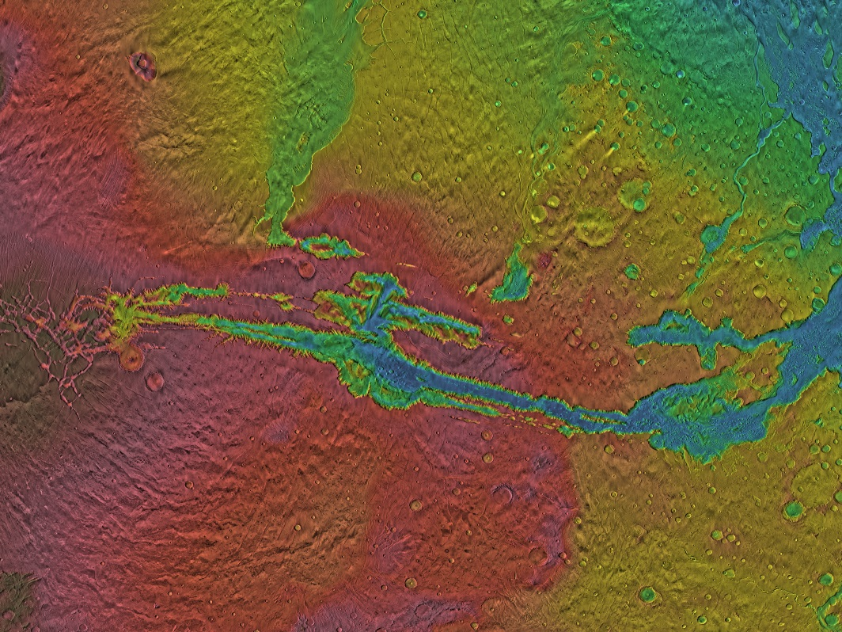
Valles Marineris – Longest Canyon on Mars
Notes:
Valles Marineris is the “Grand Canyon of Mars”. The rim of the valley is very high, so it shows up as red, but the bottom is very deep, so it shows up as blue. It is named for NASA’s Mariner 9 mission, which discovered it and sent back our first pictures of this giant feature. Valles Marineris was formed by tectonics breaking up the Martian crust, similar to what is currently happening in the Great Rift Valley in Africa. There is evidence that after it formed, some water did flow through the bottom of the canyon and out onto the Norther Plains through a series of channels to the east.

Slide 17
Valles Marineris – Longest Canyon on Mars
Notes:
At slightly over 2,500 miles long, it is longer than the entire continental United States.

Slide 18
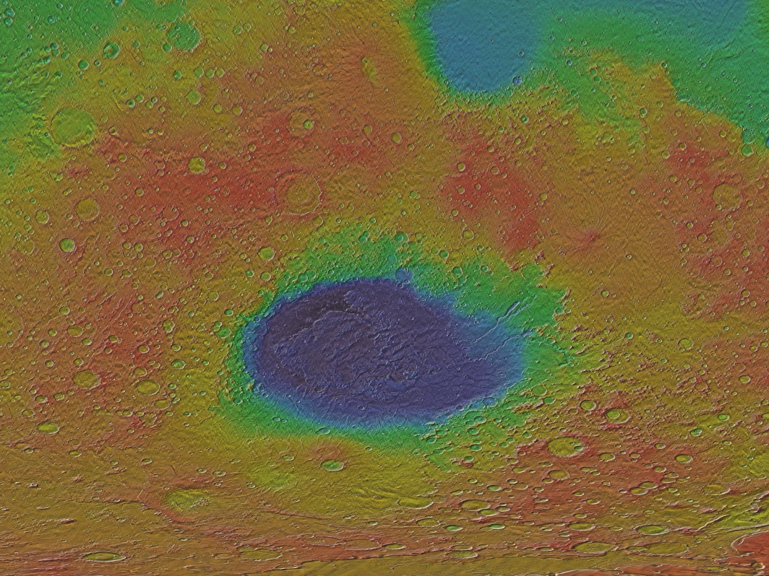
Hellas Planitia – Largest Crater on Mars
Notes:
Hellas Planitia is the largest impact crater on Mars and formed when a very large asteroid or comet hit the planet while it was still very young. The bottom of the crater is the lowest point on Mars. It is named for “Hellas”, the ancient Greek name for Greece.

Slide 19
Hellas Planitia – Largest Crater on Mars
Notes:
The diameter of Hellas Planitia is almost the same as the width of the continental United States.

Slide 20
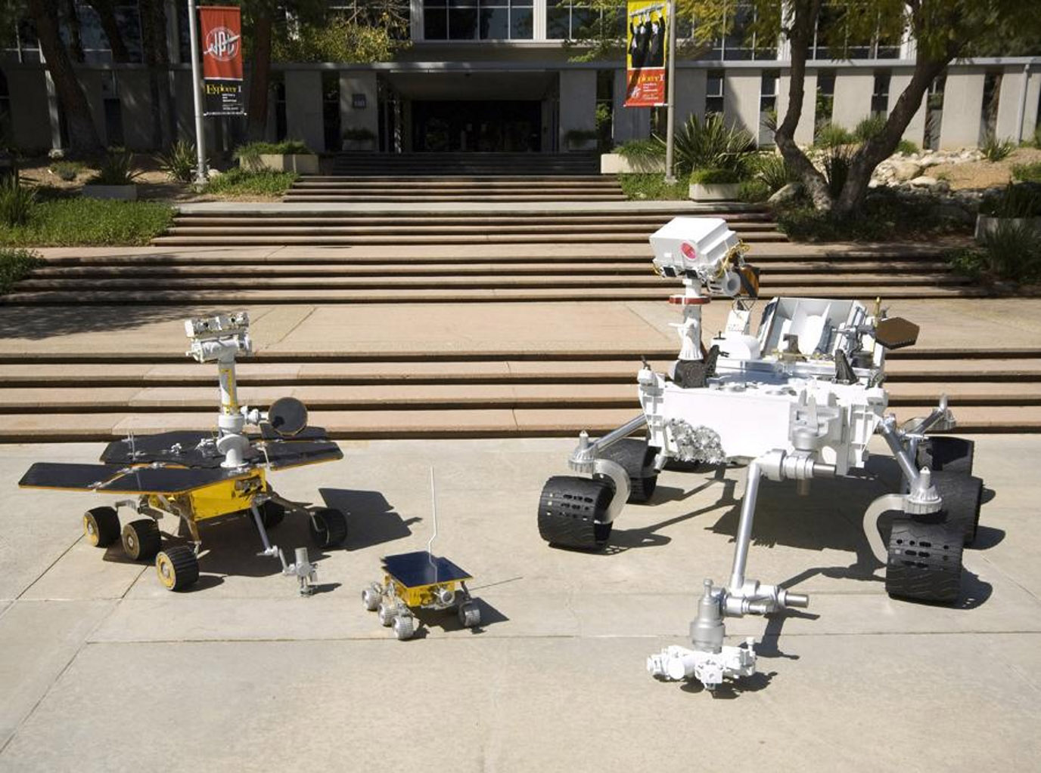
Notes:
NASA has sent a total of four rovers to explore the surface of Mars:
The Sojourner rover landed on Mars on July 4th, 1997. It was approximately the size of a microwave and survived on the surface for 83 Martian days.
The twin Spirit and Opportunity rovers landed on Mars in January 2004. They are approximately the size of a golf cart and landed on opposite sides of the planet. Spirit survived for 2,269 Martian days and Opportunity is still considered operational after more than 5,250 Martian days, although NASA hasn’t heard from it since June 2018 due to a planet-wide dust storm that has prevented its solar panels from recharging its batteries.
The Curiosity rover landed on Mars in August 2012 and has survived for more than 2,220 Martian days and is still operational. It is approximately the size of a large SUV.

Slide 21
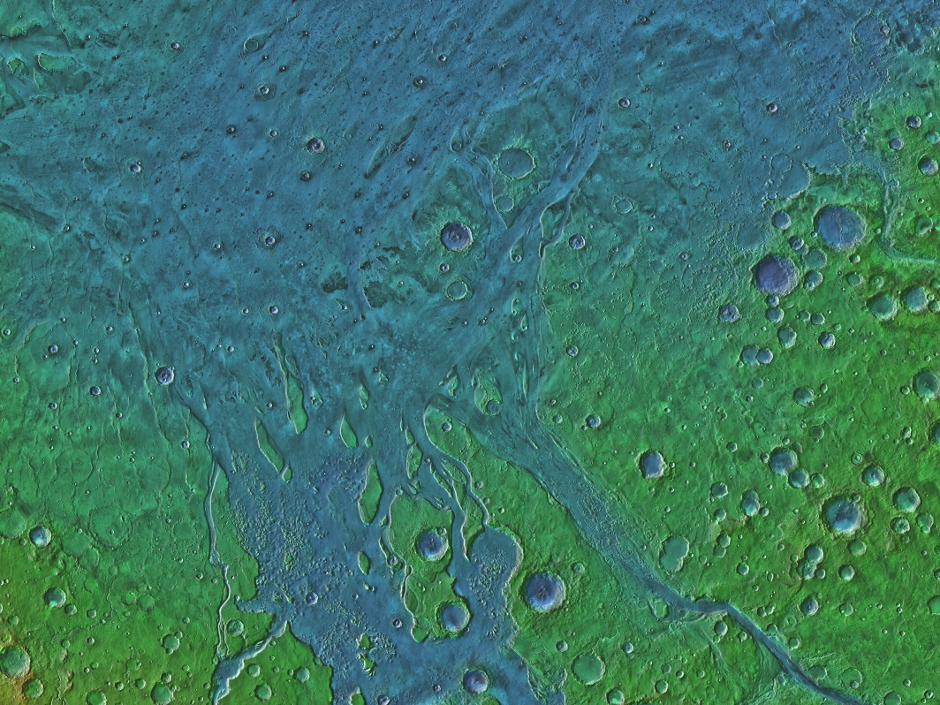
Sojourner – Ares Vallis
Notes:
NASA’s first Mars rover, Sojourner, was carried to Mars by the Pathfinder spacecraft and landed at the end of Ares Vallis, which is a long water-carved channel east of Valles Marineris.

Slide 22
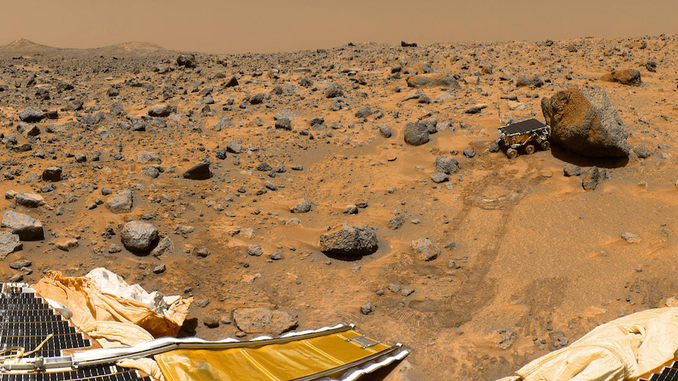
Notes:
Scientists had hoped to find rocks that had evidence of water, but instead found mostly volcanic rocks that are very similar to the volcanic rocks in Hawai’i. This means that Ares Vallis was probably carved by a sudden, massive outburst of water that dried up before it could react with the rocks and change their composition. A very similar outburst of water occurred in the Channeled Scablands in Washington State, which planetary scientists study to learn more about Ares Vallis and other water-carved channels on Mars.

Slide 23
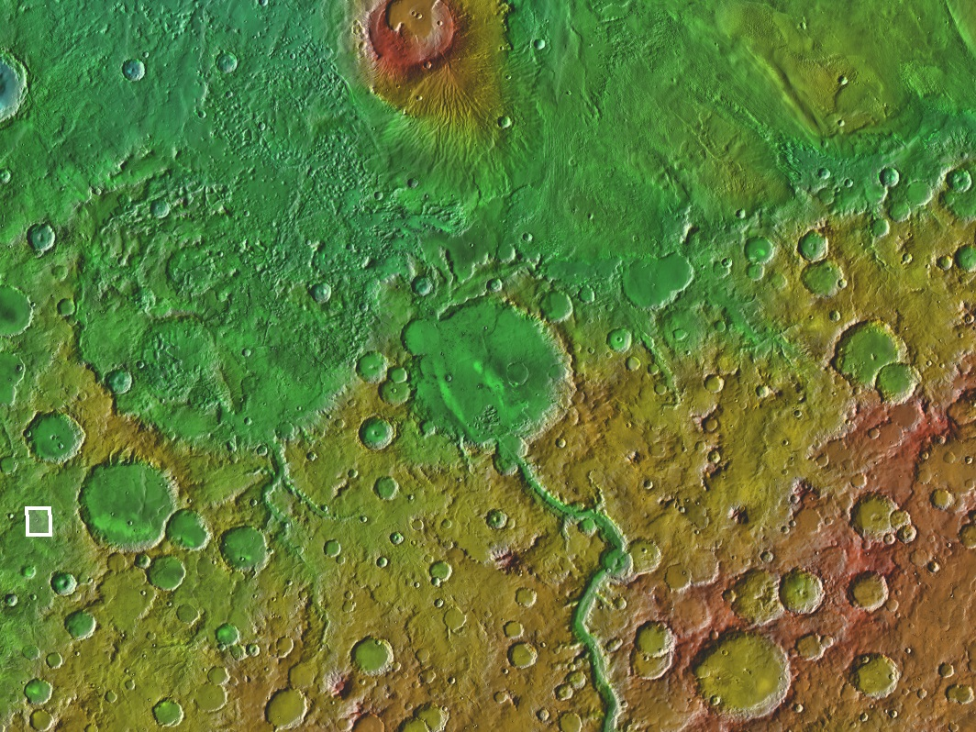
Spirit – Gusev Crater
Notes:
The first of the twin rovers, Spirit, landed near the center of Gusev Crater. Because the crater has a large channel running into it, scientists hypothesized that Gusev Crater once contained a lake. They were hoping to find lake sediments, but instead found volcanic rocks and ash that erupted after the lake dried up.

Slide 24
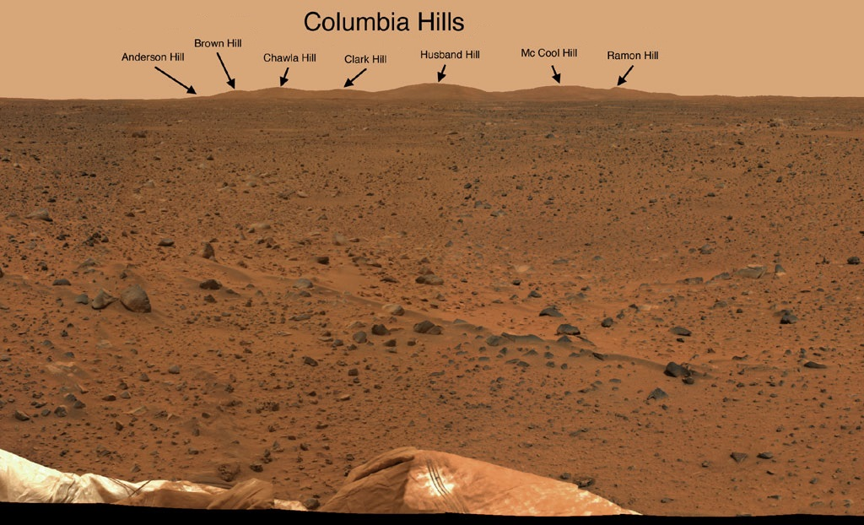
Notes:
Luckily, the rover found a small set hills that are higher than the level of the lava flows and still preserved some of the original crater floor. They were named the Columbia Hills, after the space shuttle Columbia, which was destroyed during re-entry on February 1st, 2003. Each of the seven hills were named for one of the astronauts who died in the accident.

Slide 25
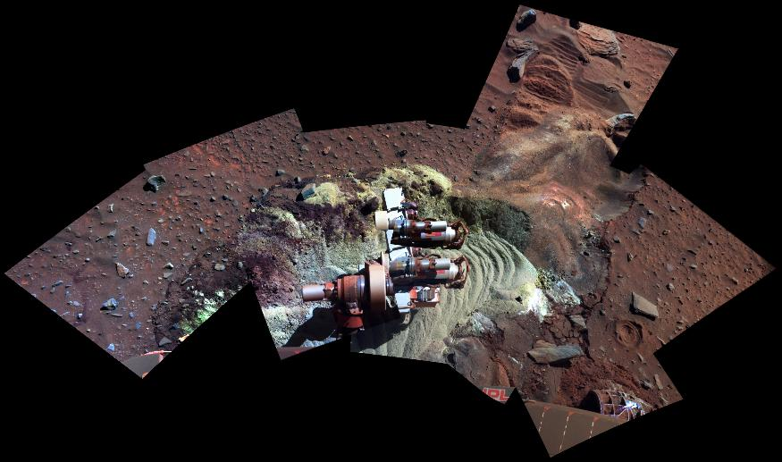
Notes:
In the Columbia Hills, Spirit found evidence of an ancient hot spring. Billions of years ago it would have looked very similar to the hot springs in Yellowstone National Park. This greenish-white soil that was dug up by the rover’s wheels was one of the clues that led scientists to the hot spring hypothesis.

Slide 26
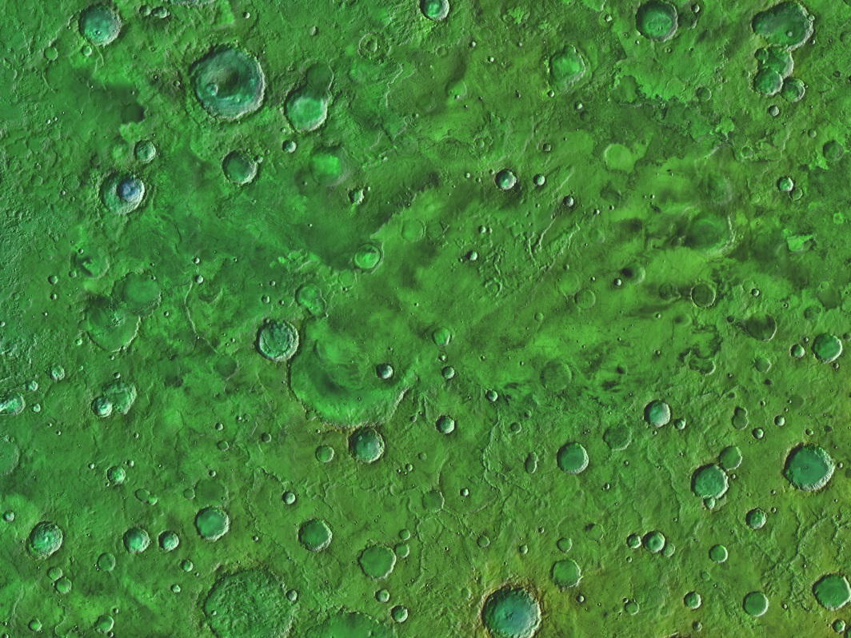
Opportunity – Meridiani Planum
Notes:
Opportunity, the second of the twin rovers, landed on Mars three weeks after Spirit in an area called Meridiani Planum. It looks fairly plain in most images…

Slide 27
Notes:
But measurements from orbiting spacecraft had shown that Meridiani Planum is the only place on Mars with high concentrations of a mineral called hematite. Scientists are interested in hematite because it almost always forms in the presence of liquid water.

Slide 28
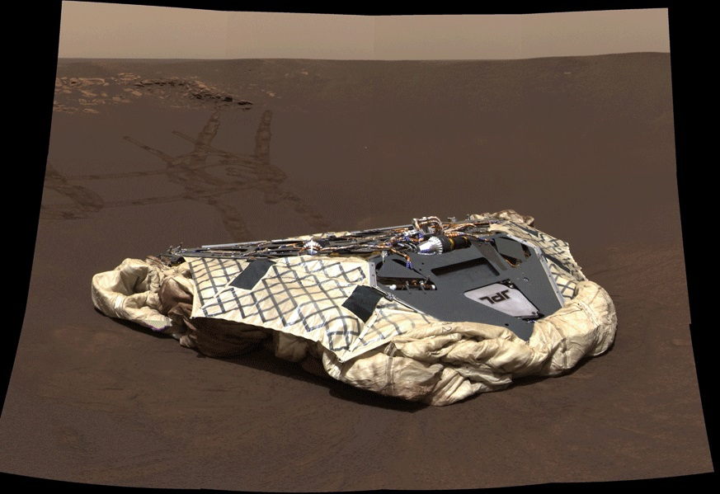
Notes:
As soon as Opportunity landed, the scientists immediately noticed thousands of small BB-sized spheres scattered around on the surface.

Slide 29
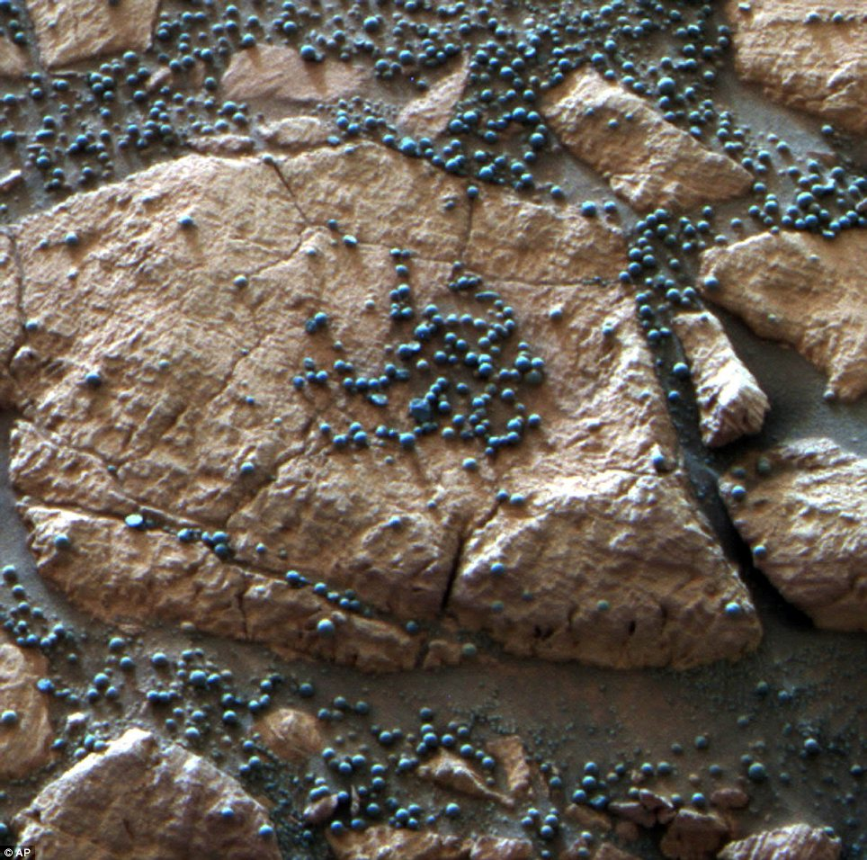
Notes:
After analysis by all of the rover’s instruments, the science team determined that the little spheres, which they nicknamed “blueberries”, are made almost entirely of hematite. Hematite spheres similar to these form in environments on the Earth where groundwater flows through iron-rich sedimentary rocks. The best known examples on Earth are in Zion National Park in southern Utah.

Slide 30
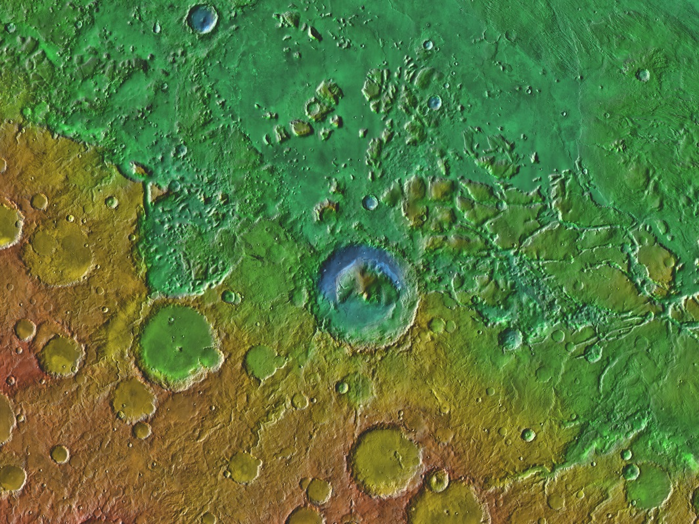
Curiosity – Gale Crater
Notes:
Curiosity, NASA’s newest and largest rover, landed on Mars in August 2012. The landing site was in Gale Crater, which scientists believe used to hold a lake based on the many small channels leading into it and the types of minerals on the crater floor. There is also a mountain of sediments in the center of the crater, which scientists hope contains a geologic record of the last billion years of Mars’ history.

Slide 31
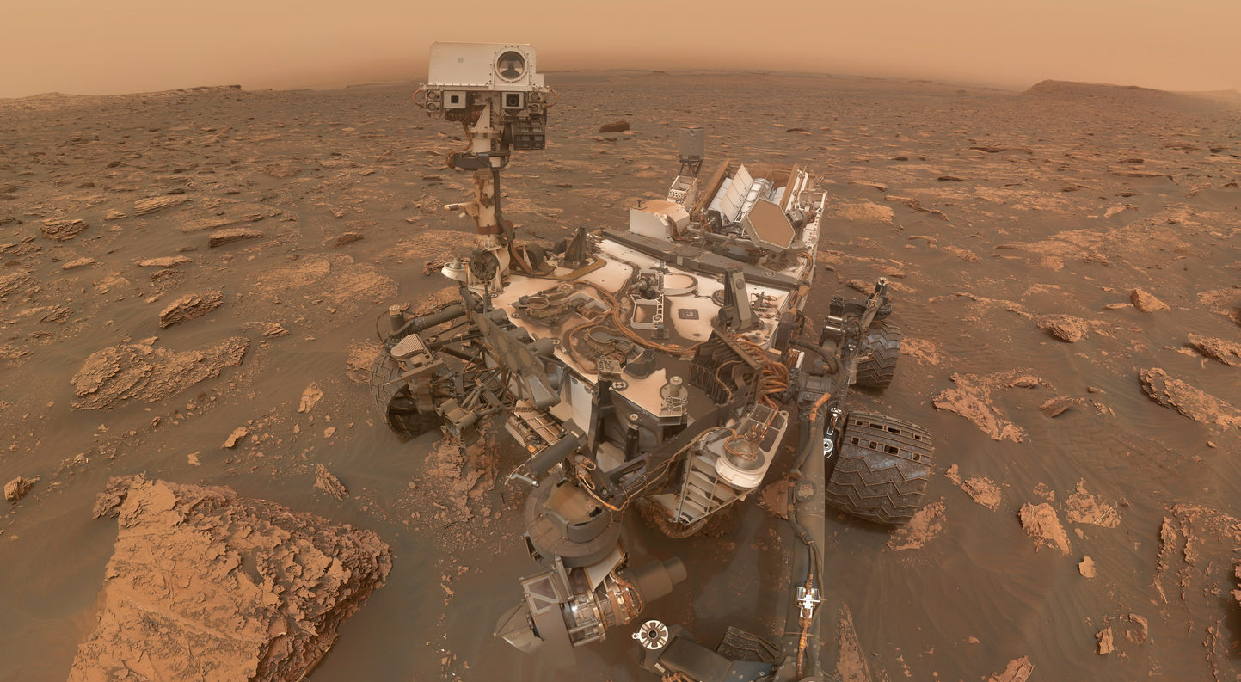
Notes:
Curiosity has found many layers of mudstone, which is formed in consistently wet environments, like at the bottoms of lakes. The rock in the bottom-left of this image is a good example of mudstone. Notice the very fine layers and the irregular edges of each layer where they are being eroded away.

Slide 32
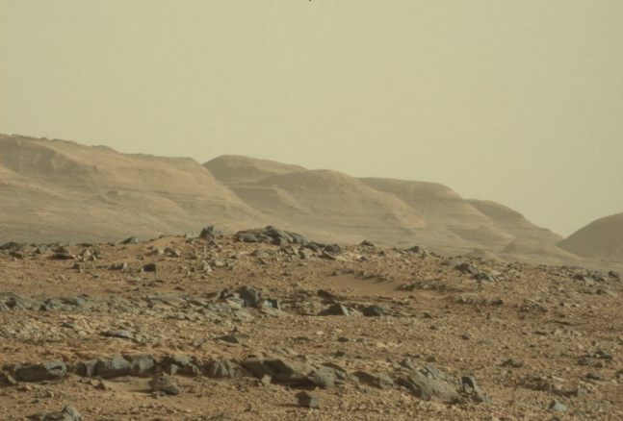
Notes:
Curiosity has finished exploring the bottom of the crater where the mudstones and lake deposits are found, and is now slowly climbing up the central mountain, which has been nicknamed “Mt. Sharp”. It will study each layer of the mountain as it climbs, which will tell us how the Martian environment changed over approximately the last billion years.

Slide 33
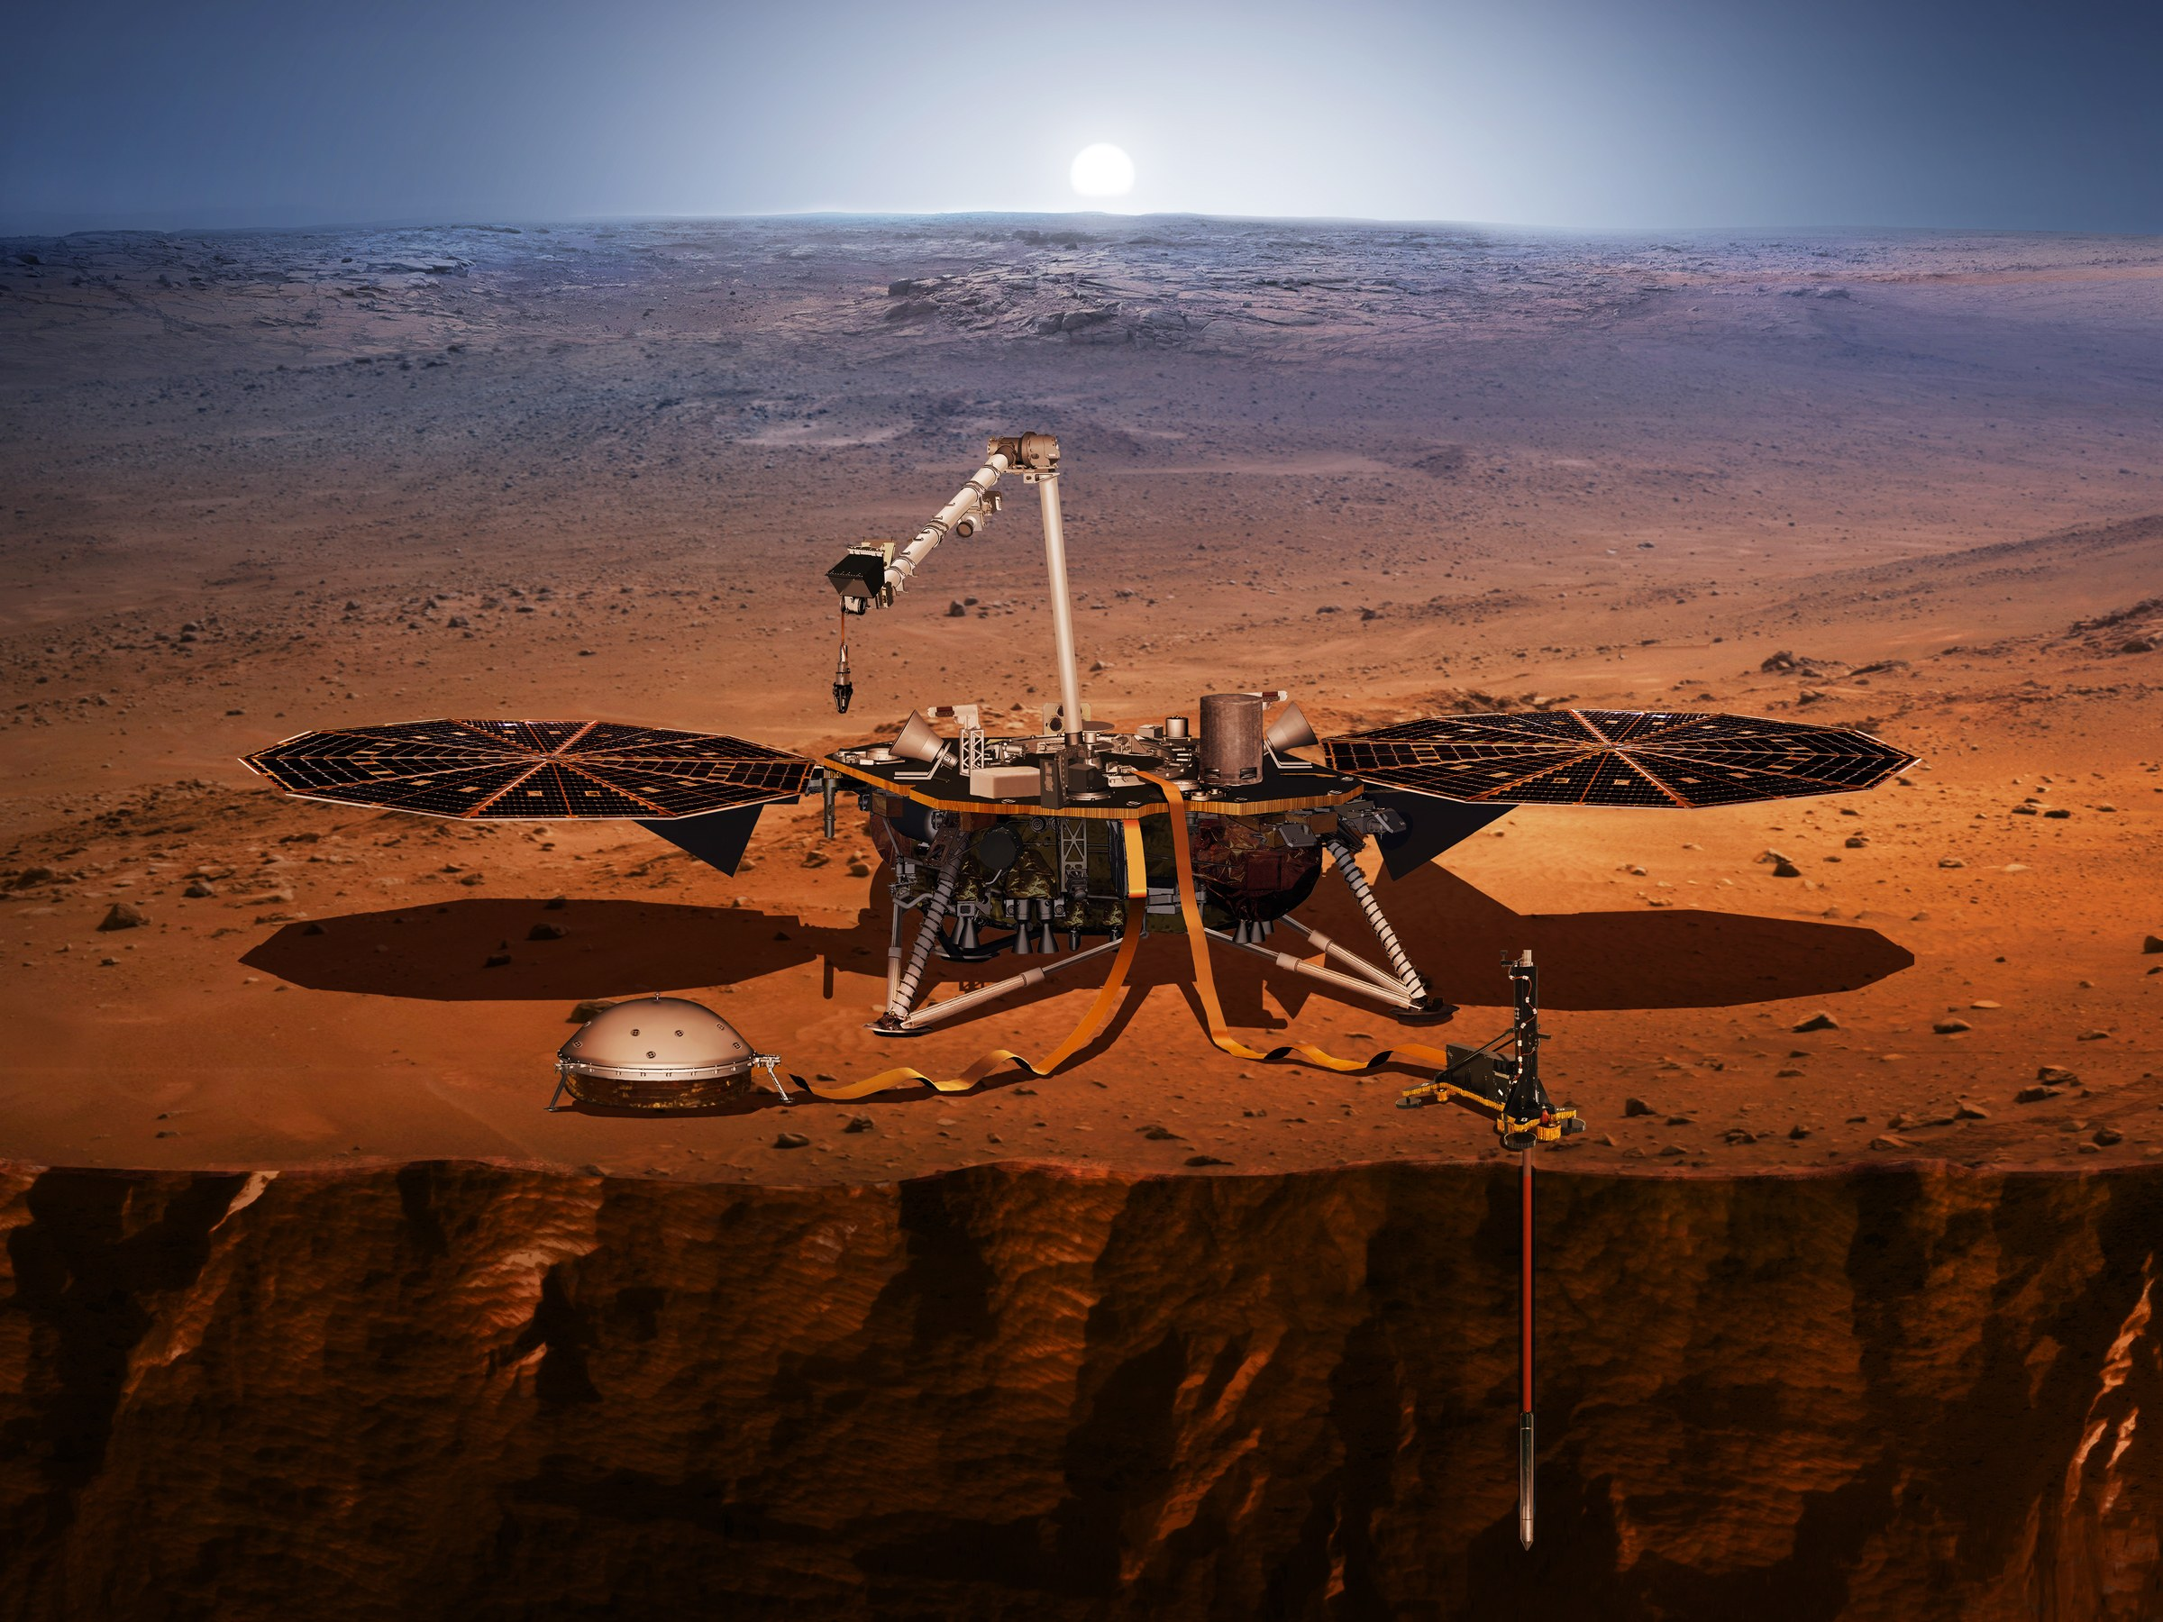
InSight – Elysium Planum
Notes:
NASA’s newest mission to Mars, which is called InSIGHT, landed on November 26th, 2018. InSight is a stationary lander instead of a rover because the science instruments it carries need to stay in one place to work properly. The first main instrument is a seismometer, which will measure Mars-quakes and study how they reflect off of the planet’s core, which will give us our first insight into what the interior of Mars looks like. The second main instrument is a heat probe, which will drill 5 meters (16 feet) underground, where it will be able to measure how much heat is coming from Mars’ core, which will tell us how quickly or slowly the interior of Mars is cooling.

Slide 34
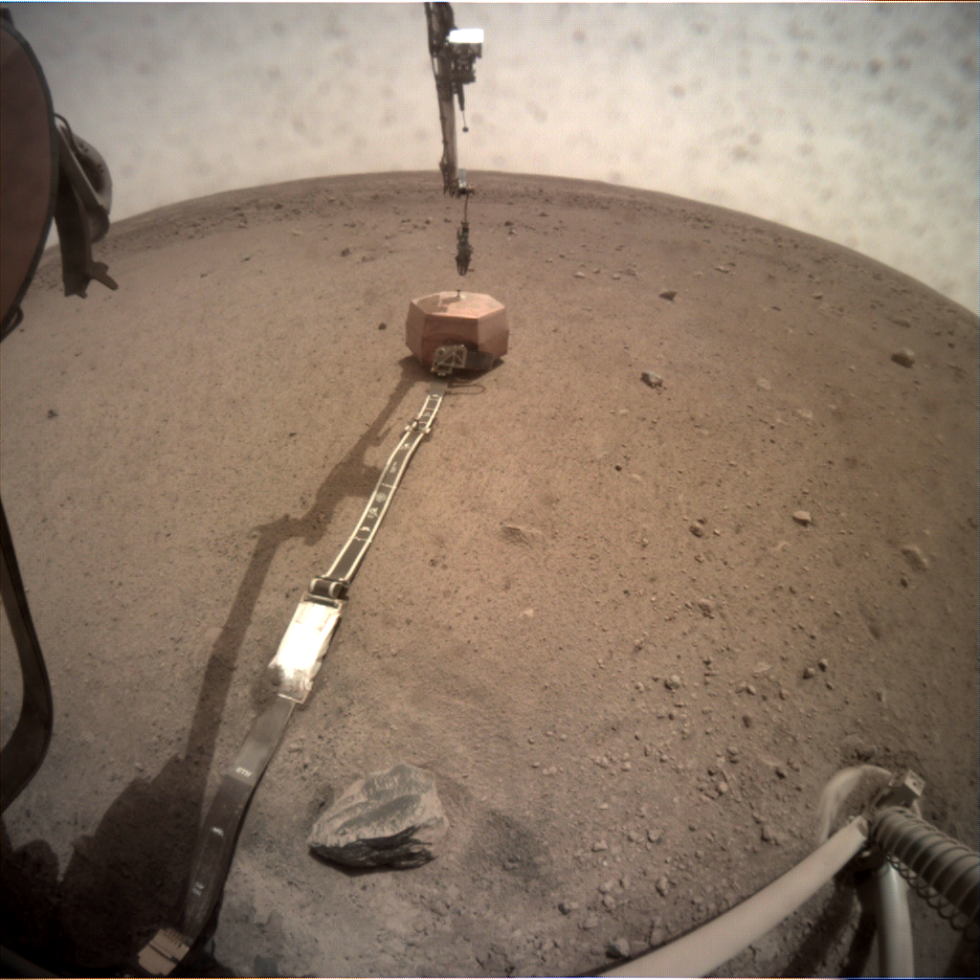
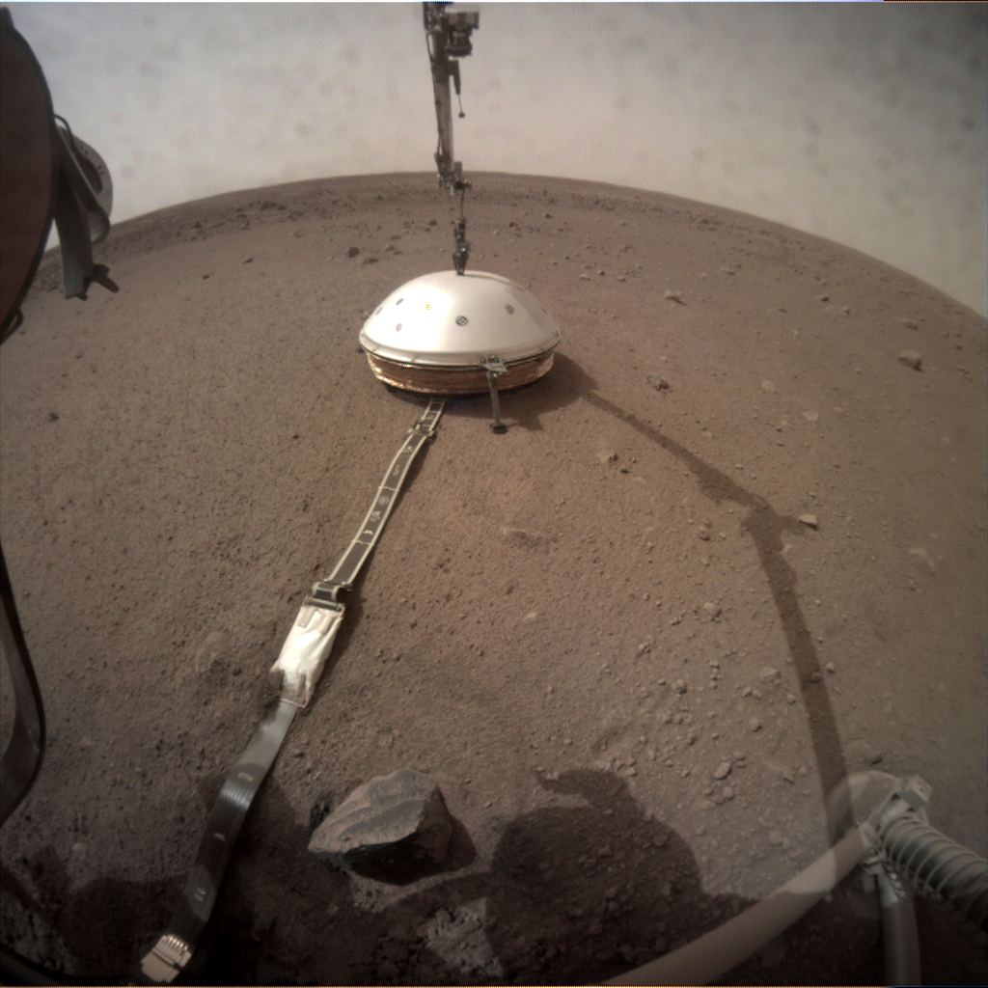
Notes:
The first instrument InSIGHT is putting on the surface is the seismometer. The left image shows the copper-colored seismometer on the surface in front of the lander. The right image shows the seismometer’s cover being gently lowered on top of it. The cover will protect the delicate seismometer from the wind, which is important because if the seismometer shakes due to the wind, scientists might mistake the shaking for a Marsquake.

Slide 35
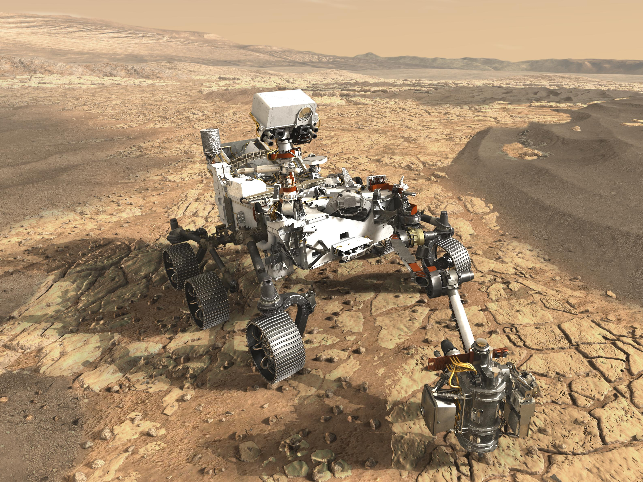
Perseverance – Jezero Crater
Notes:
NASA’s newest rover landed on Mars in February 2021. It’s landing site was in a crater called Jezero Crater, which contains a dry river delta. This means that not only was there a lot of liquid water there for a long time, but the rocks are also very old, which will tell us what the surface of Mars was like when the planet was very young. In addition to a full payload of science instruments, the rover will carry a drill on its robotic arm capable of extracting small samples from rocks and sealing them in metal tubes.

Slide 36
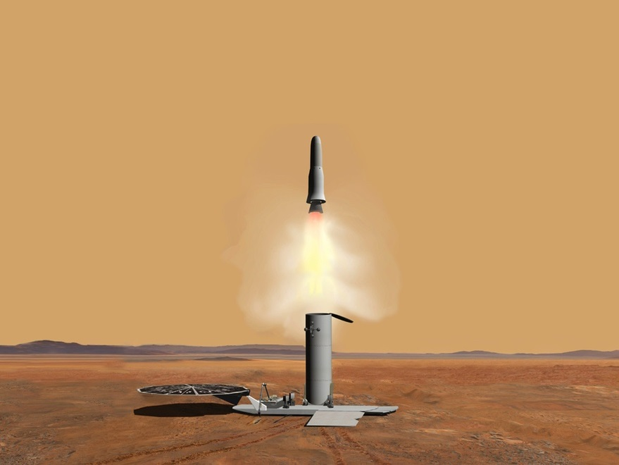
Notes:
Those metal sample tubes will be collected by a future rover, placed inside a canister and then launched into orbit around Mars.

Slide 37
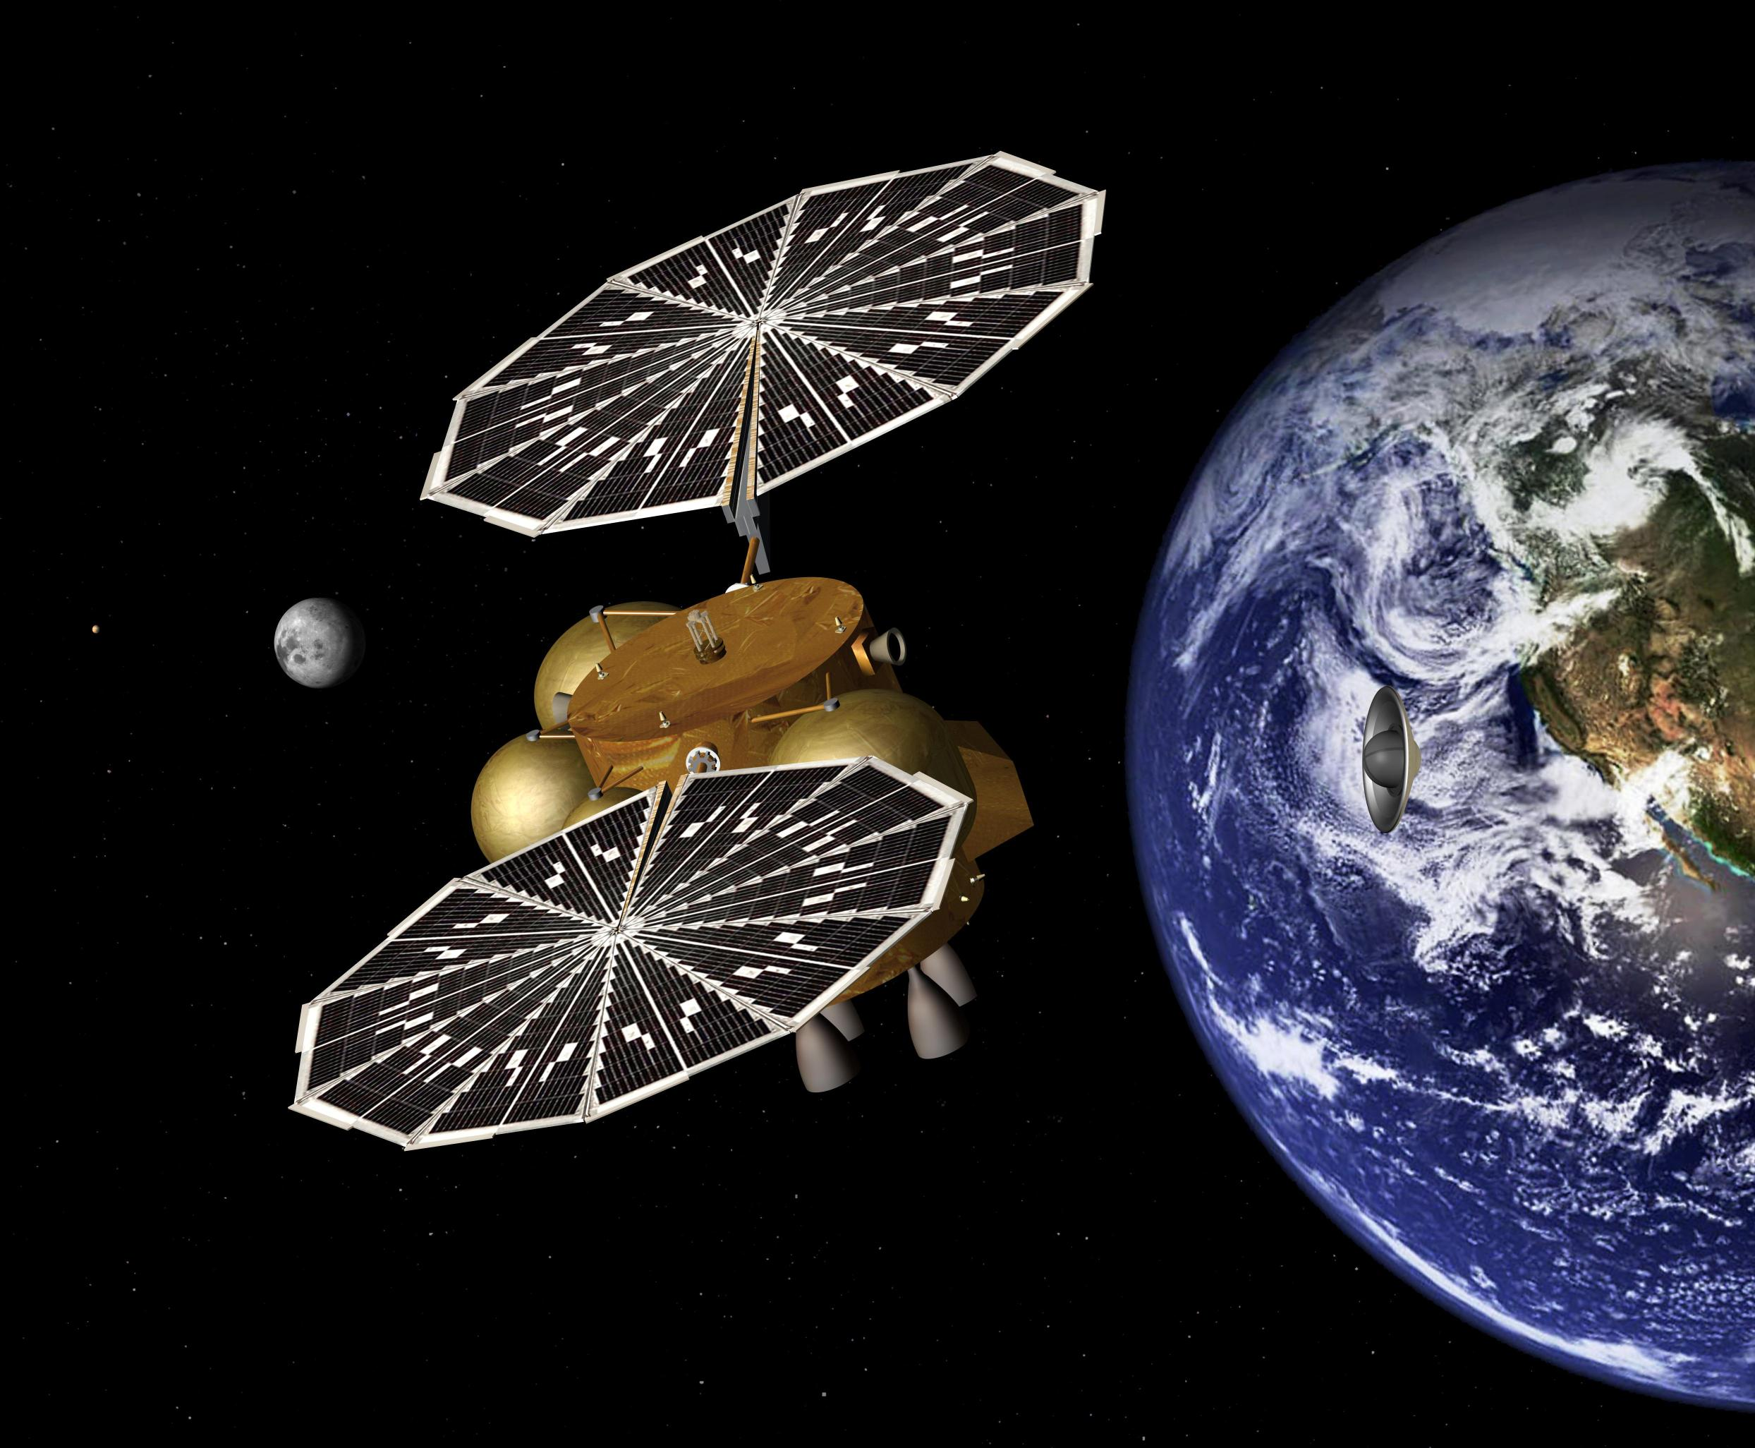
Notes:
Finally, a satellite will collected the sample canister from Mars orbit and bring it back to Earth. This will be the first time that we have returned samples of Mars to Earth, which will allow scientists to study them using state-of-the-art laboratory equipment that is too large or too heavy to put on a rover.

Slide 38
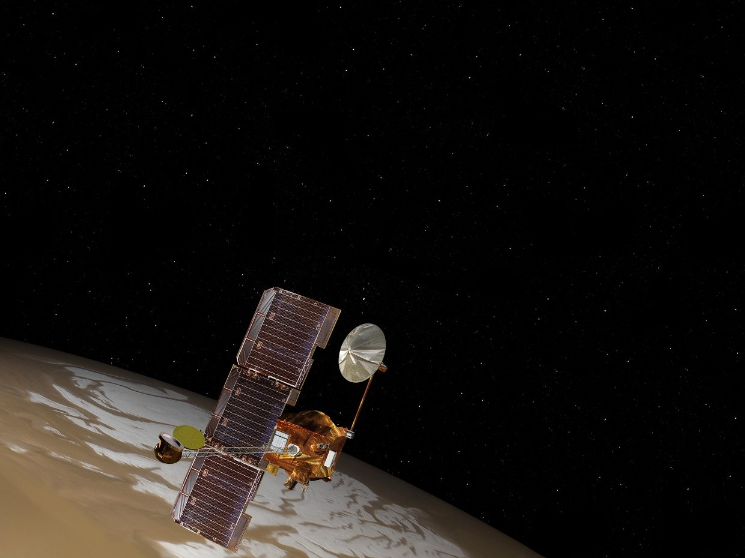
Notes:
Another successful mission to the Red Planet is the Mars Odyssey spacecraft, which is named after the movie “2001: A Space Odyssey” by Arthur C. Clarke and Stanley Kubrick. It was launched in April 2001 and arrived at Mars 7.5 months later in October 2001.

Slide 39
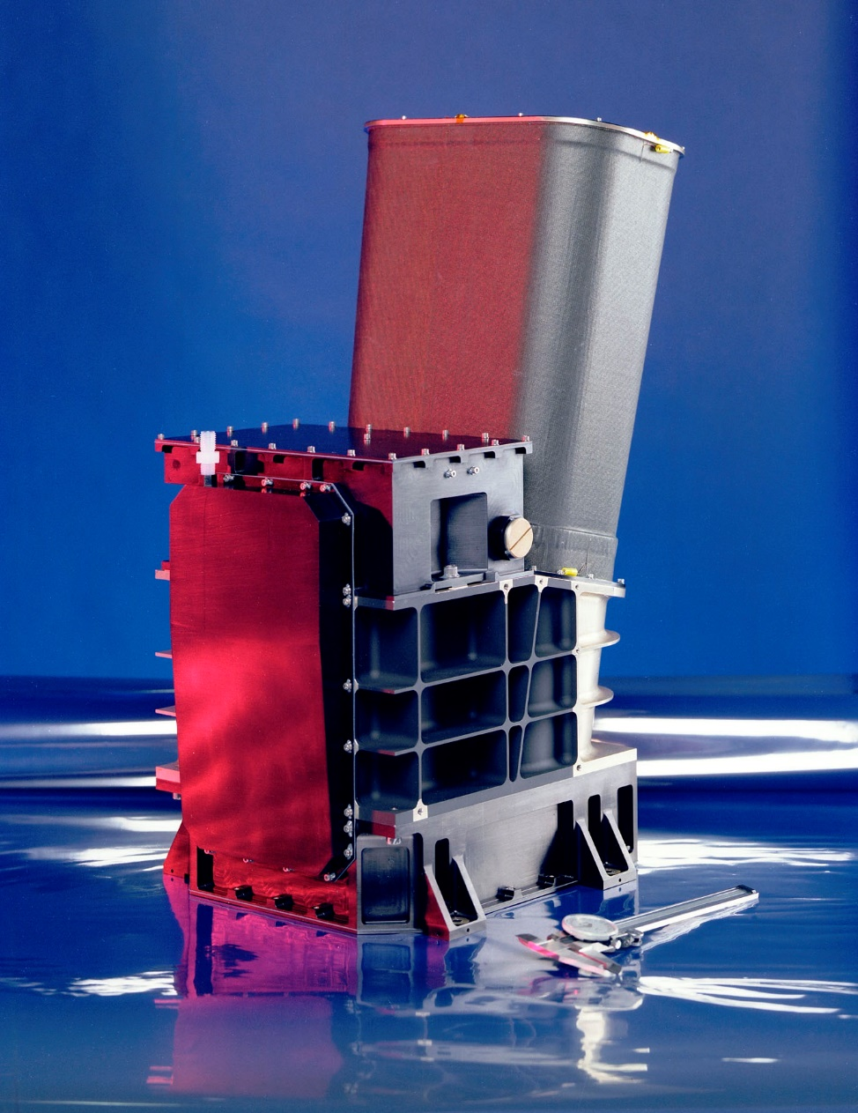
Notes:
One of the science instruments on Mars Odyssey is the THEMIS camera, which takes both visible and infrared (heat) images. THEMIS stands for the “Thermal EMission Imaging System” and was build by Arizona State University (ASU). The THEMIS team at ASU has been using THEMIS to take images of the Martian surface for over 21 years. The best 24,000 infrared images collected during that time have been digitally stitched together to create a seamless global map of Mars.

Slide 40
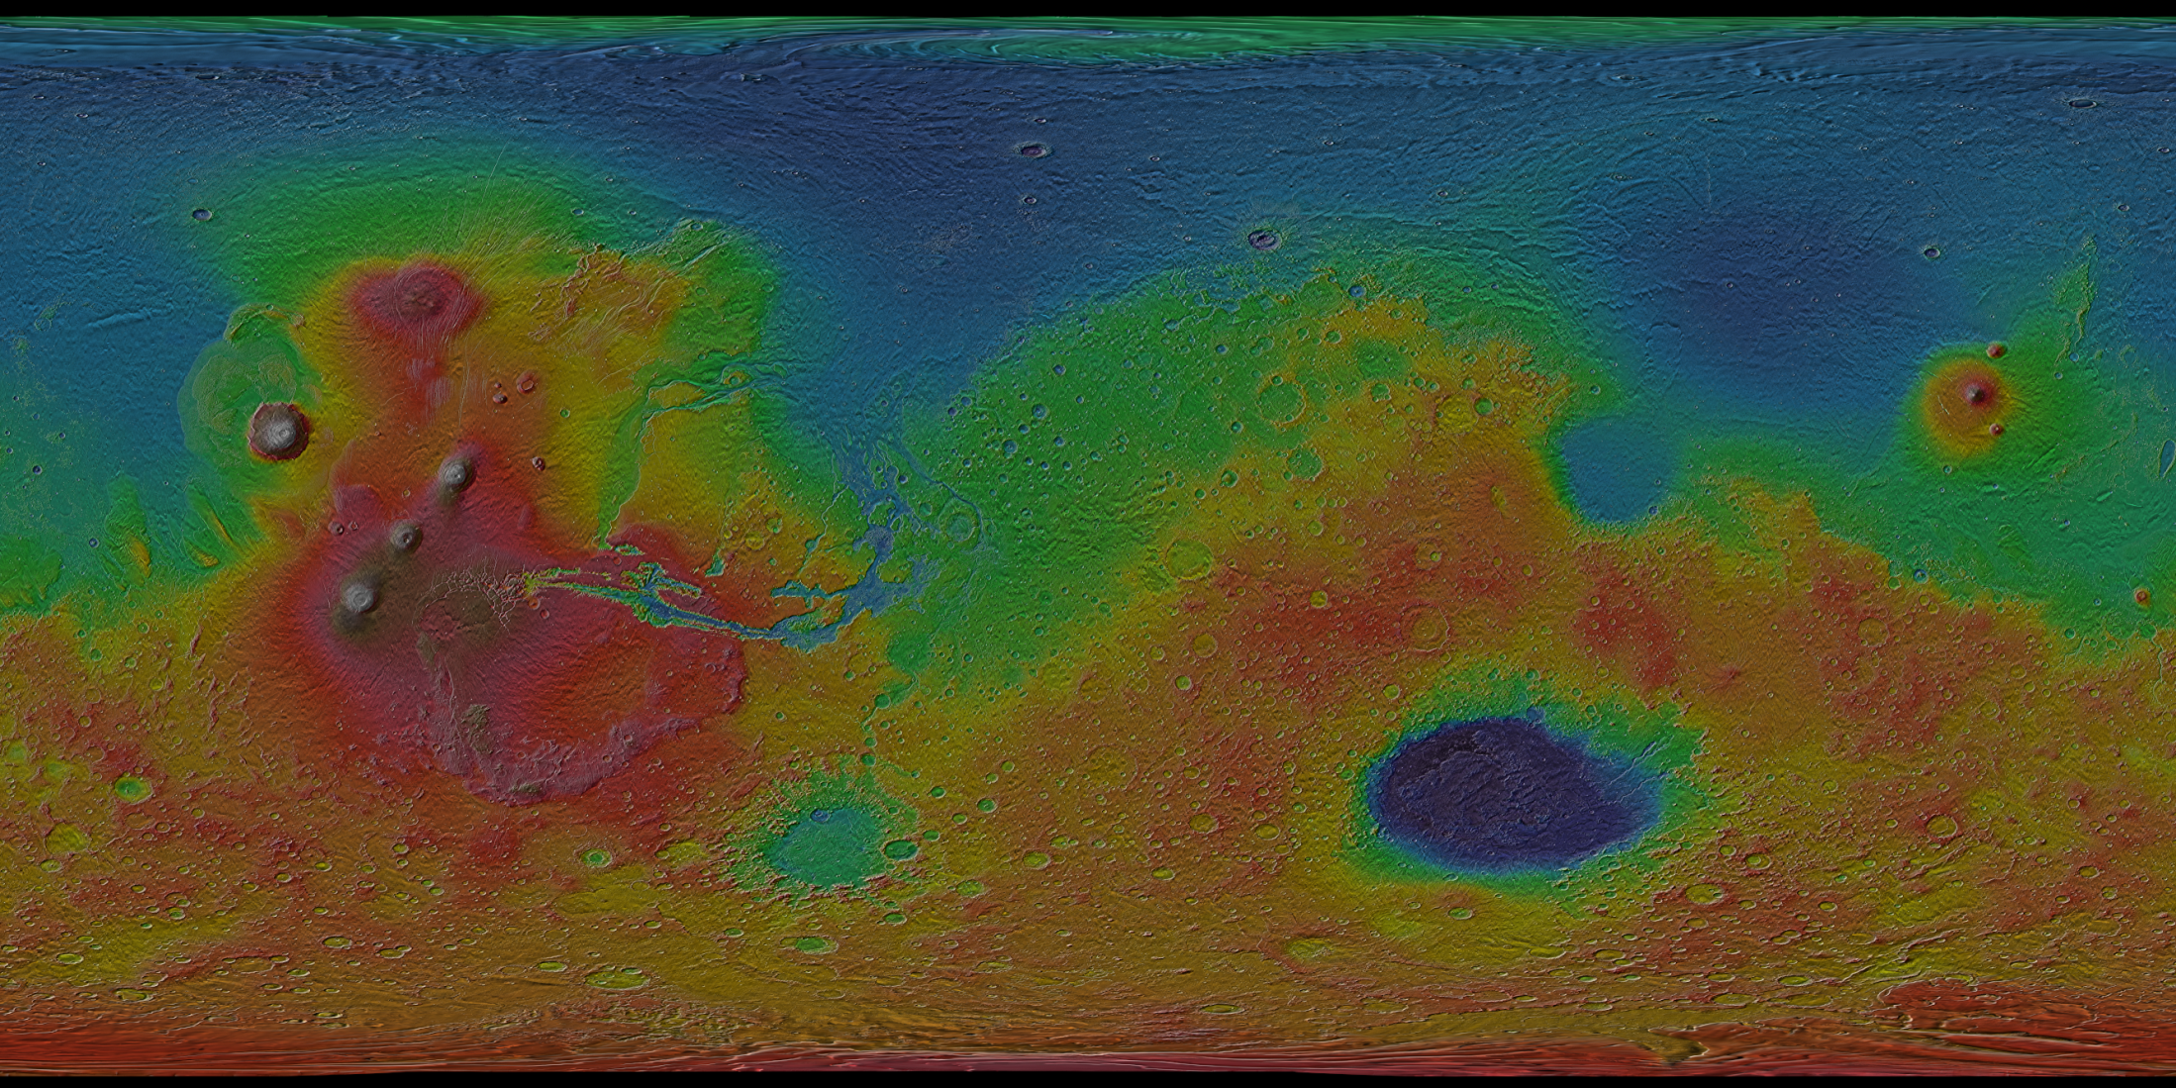
Notes:
This map has a resolution of 100 meters per pixel, which means that each square pixel has sides approximately the length of a football field. Although we have higher resolution image maps of the Earth, this is the first time that Mars has been mapped in this much detail. Because the infrared map is only black-and-white (black = cold, white = hot), the THEMIS team colorized it by using topography data.

Slide 41
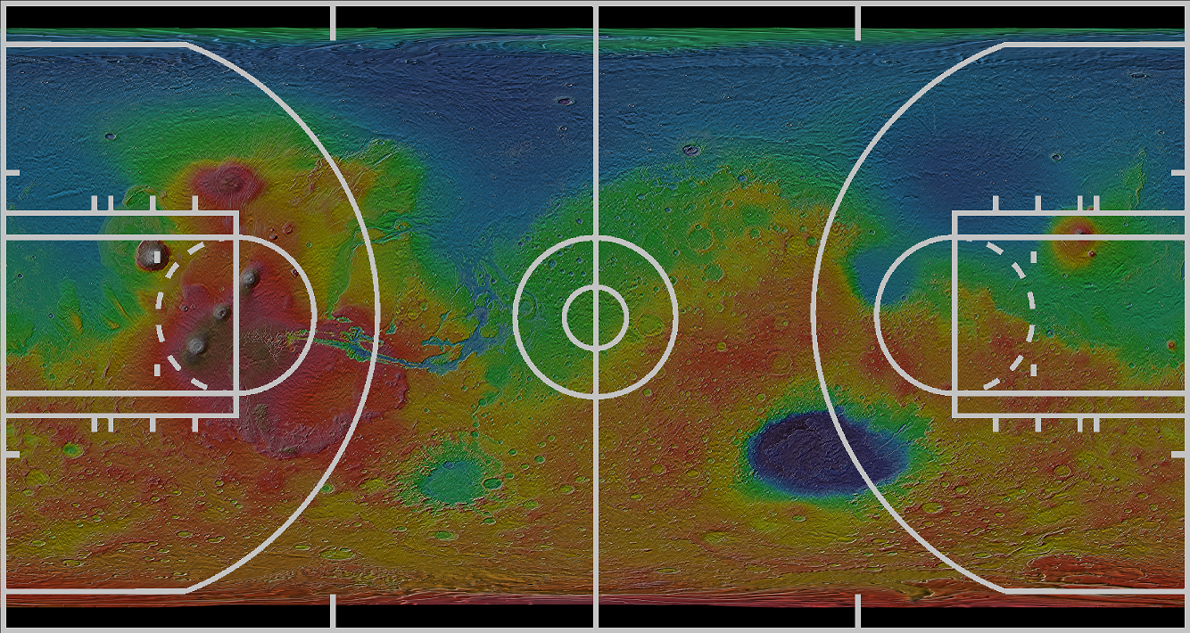
Notes:
The THEMIS team then printed the map at full-resolution, which makes it the size of a basketball court. The map is printed on a reinforced vinyl material that people can walk on in socks (shoes and bare feet could damage the printed surface).

Slide 42
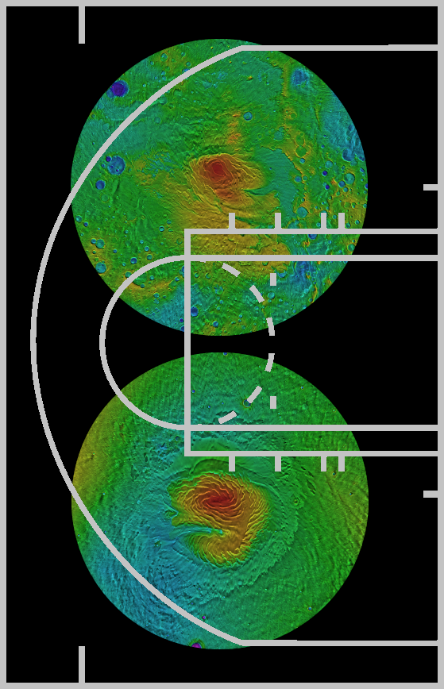
Notes:
Because the north and south poles are distorted in a rectangular map, the THEMIS team also printed circular maps centered at both the north and south poles, so people can see the polar ice caps, which are made of both water (H₂O) ice and dry (CO₂) ice.

Slide 43
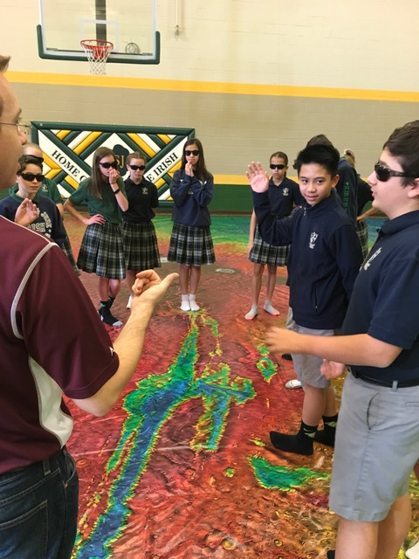
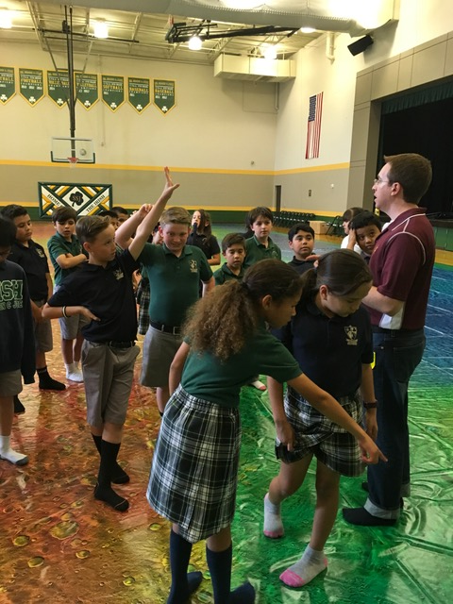
Notes:
ASU and the THEMIS team have been bringing this giant Mars map to schools in order to teach students about Mars and Mars exploration. And your school is next! So to make sure you’re ready to explore the map, please remember:
Bring socks (shoes and bare feet are not allowed on the map)
No running or sliding on the map, since that could damage the printed surface.
No food, drinks or gum are allowed on the map.
If you have any questions about Mars, feel free to ask your Martian tour guide as you explore the map.

Slide 44
See You on Mars!
Notes:
See you on Mars!

